Slide 1
THE FEAST
OF
TABERNACLES
September 25, 2016

Slide 2
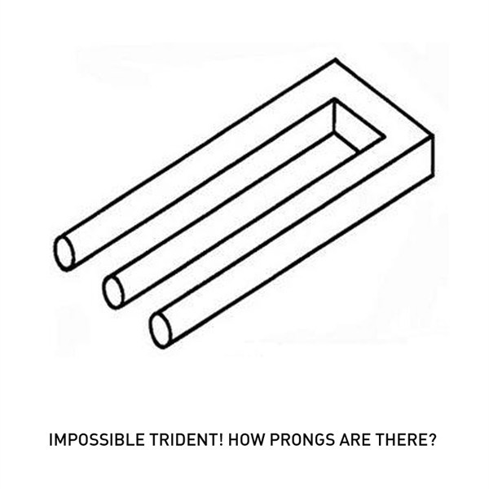

Slide 3
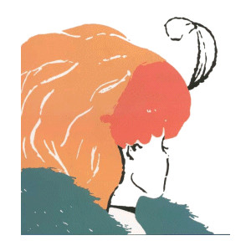

Slide 4


Slide 5


Slide 6
I. The FEASTS

Slide 7
Leviticus 23:2-4 (NKJV)
² 'The feasts of the LORD, which you shall proclaim to be holy convocations, these are My feasts.³ 'Six days shall work be done, but the seventh day is a Sabbath of solemn rest, a holy convocation.

Slide 8
Leviticus 23:2-4 (NKJV)
You shall do no work on it; it is the Sabbath of the LORD in all your dwellings. ⁴ 'These are the feasts of the LORD, holy convocations which you shall proclaim at their appointed times.

Slide 9
CONVOCATION:
MIQRA: (dress) Rehearsals, public meetings
MOED:
Signs, seasons, appointed time

Slide 10
Deuteronomy 16:16 (NKJV)
¹⁶ Three times a year all your males shall appear before the LORD your God in the place which He chooses: at the Feast of Unleavened Bread, at the Feast of Weeks, and at the Feast of Tabernacles; and they shall not appear before the LORD empty-handed.

Slide 11
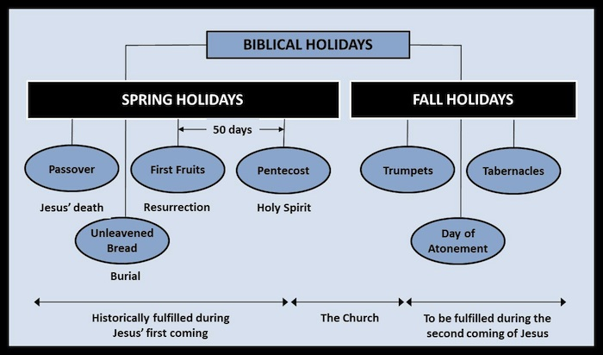

Slide 12
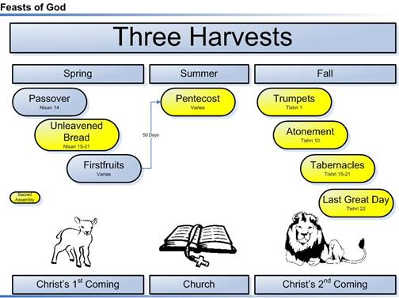

Slide 13
The FEASTS
Passover: The Paschal lamb was slain.

Slide 14
The FEASTS
Passover: The Paschal lamb was slain.
Jesus died on Passover as the Paschal Lamb

Slide 15
The FEASTS
Feast of Unleavened Bread
Got rid of all leaven (sin and pride). Set apart, sanctified

Slide 16
The FEASTS
Feast of Unleavened Bread
Got rid of all leaven (sin and pride). Set apart, sanctified
JESUS is BURIED. Sin is put away

Slide 17
The FEASTS
Feast of FIRSTFRUITS

Slide 18
The FEASTS
Feast of FIRSTFRUITS
JESUS is the FIRST FRUITS OF THE RESURRECTION. We will be with him when we are resurrected!

Slide 19
The FEASTS
Feast of PENTECOST
50 Days after Passover.
PENTE-50
First Pentecost was when MOSES met with God in the Mount

Slide 20
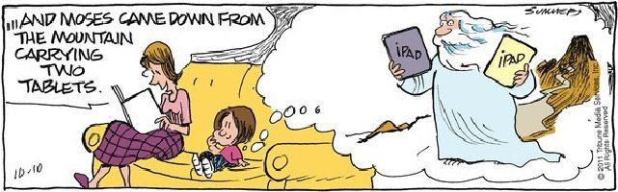

Slide 21
The FEASTS
FULFILLED at the DAY OF PENTECOST when the Holy Spirit is poured out on the church!
In the Mount: Israel is born as a Nation
Day of Pentecost: the church is BORN in the SPIRIT

Slide 22
Rosh Hashana | Oct 3-4, 2016 M‑Tu | The Jewish New Year
Yom Kippur | Oct 12, 2016 W | Day of Atonement
Sukkot | Oct 17-18, 2016 M‑Tu Oct 19-23, 2016 W‑Su | Feast of Tabernacles

Slide 23
The FEASTS
ROSH HASHANAH
FEAST OF TRUMPETS

Slide 24
The FEASTS
ROSH HASHANAH
FEAST OF TRUMPETS
The calling of God to get ready for ATONEMENT
10 days of AWE

Slide 25
The FEASTS
YOM KIPPUR
THE DAY OF ATONEMENT

Slide 26
The FEASTS
YOM KIPPUR
THE DAY OF ATONEMENT
The most holy day when the High Priest entered behind the veil in the Most Holy Place to meet with God on behalf of Israel

Slide 27
The FEASTS
The Slain Goat and the Scape Goat

Slide 28
The FEASTS
The FEAST OF TABERNACLES
The Feast of Ingathering

Slide 29
The FEASTS
The FEAST OF TABERNACLES
The Feast of Ingathering
The final celebration, when the year is completed

